Slide 1

CodeZilla
Team - 11
Amudhan Manisekaran – Kartik Mathpal – Mayank Rawat - Sandya Manoharan
Compiler and Virtual Machine for a
Programming Language
SER 502
Arizona State University, Tempe, AZ, USA

Slide 2
Data Types:
Operations:
Integer
Float
String
Boolean
Addition ( + )
Subtraction ( - )
Multiplication ( * )
Division ( / )
Comparison ( <, >, <=, >=, == )
AND, OR, NOT (Boolean)
Assignment ( = )
Conditionals & Looping Structures:
if then
if then else
Ternary ( $ )
while loop
Traditional for loop
Range for loop
read
show

Slide 3
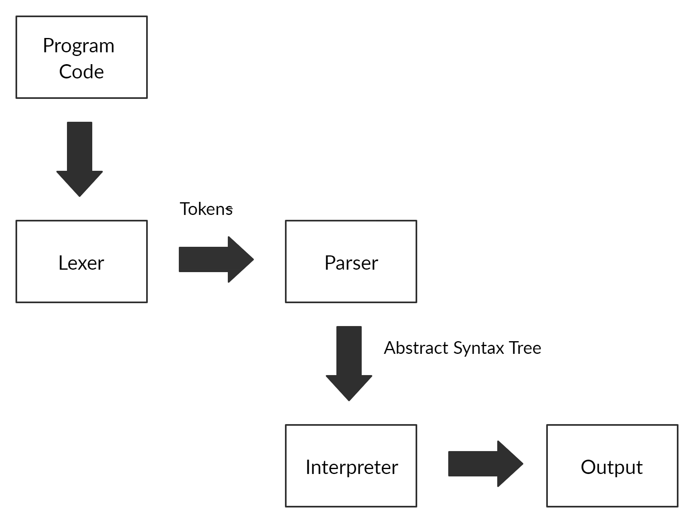
Language Design

Slide 4
Lexer
Parser
Interpreter
In Python
Read .cz
Break down code
Return .tok
In Prolog
Read .tok
Check syntax
Return parse tree
In prolog
Read .pt
Check semantics
Evaluate output

Slide 5
Grammar Rules
PROGRAM ::= start; BLOCK end;
BLOCK ::= DECLARELIST; CONDITIONLIST;
DECLARELIST ::= DECLARE; DECLARELIST | DECLARE
DECLARE ::= var ID | str ID
CONDITIONLIST ::= CONDITION; CONDITIONLIST | CONDITION
CONDITION ::= ASSIGN | IF | TERNARY | LOOPS | show DATA endshow| read ID endread
Conditional Operations:
ASSIGN ::= ID = EXPSET | ID = STRING | ID = BOOL
IF ::= if BOOL then CONDITIONLIST endif | if BOOL then CONDITIONLIST
else CONDITIONLIST endif
TERNARY ::= ID = BOOL $ EXPSET / EXPSET endternary
LOOPS ::= while BOOL do CONDITIONLIST endwhile | for (ID = VALUE ; BOOL ; EXPSET):
CONDITIONLIST endfor | for ID inrange (VALUE : VALUE): CONDITIONLIST endfor
Boolean Expressions:
BOOL ::= true | false | BOOL and BOOL | BOOL or BOOL | not (BOOL) | BOOL LESSTHAN BOOL |
BOOL GREATERTHAN BOOL | BOOL LESSTHANEQUAL BOOL |
BOOL GREATERTHANEQUAL BOOL | BOOL EQUAL BOOL.

Slide 6
Grammar Rules
Arithmetic Expressions:
EXPSET ::= EXP | ID = EXPSET
EXP ::= EXP + TERM | EXP – TERM | TERM
TERM ::= TERM / FACTOR | TERM * FACTOR | FACTOR
FACTOR ::= VALUE | ( EXPSET )
VALUE ::= ID | INT | FLOAT
Identifiers:
ID ::= ^ [a-z] $
INT ::= ^ [0-9]+ $
FLOAT ::= ^ [0-9]+ \ . [0-9] $
STRING ::= << ^[a-z] [a-zA-Z]+ $ >>
Keywords:
DATA ::= STRING | ID
LESSTHAN ::= <
LESSTHANEQUAL ::= <=
GREATERTHAN ::= <
GREATERTHANEQUAL ::= <=
EQUAL ::= ==

Slide 7
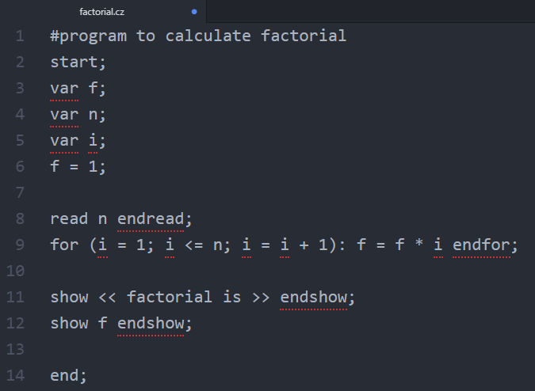
CodeZilla (factorial.cz) file

Slide 8
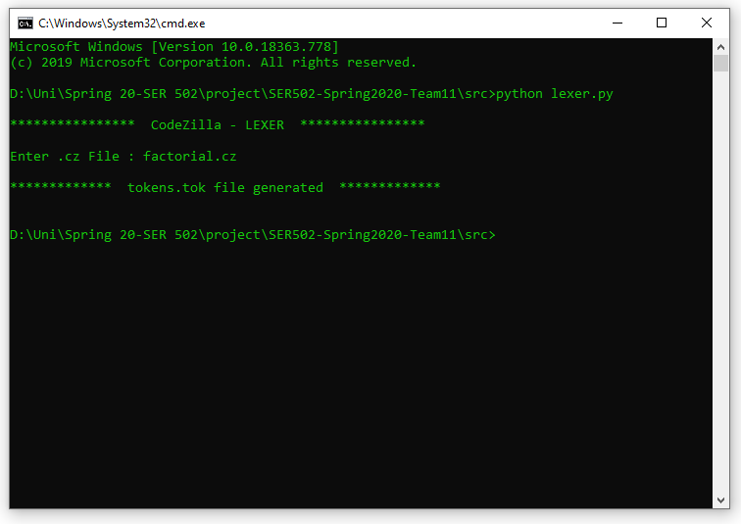
Lexer

Slide 9
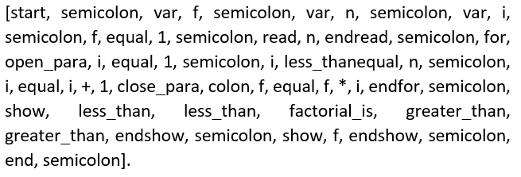
factorial.tok

Slide 10
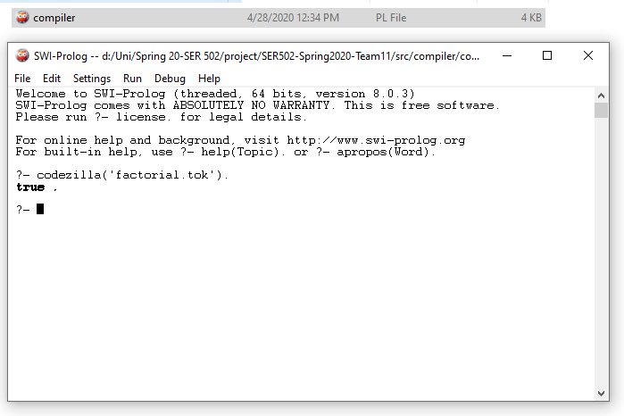
Parser

Slide 11
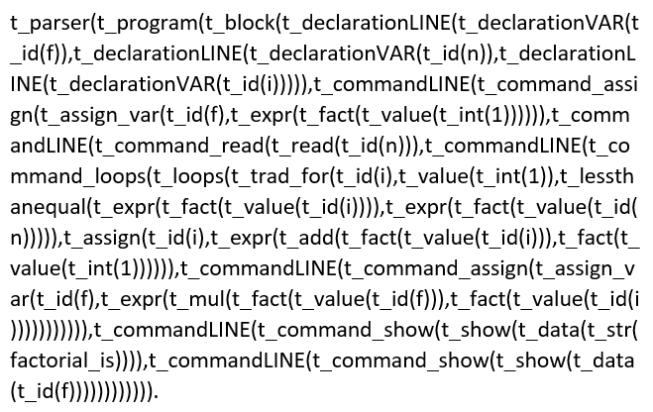
factorial.pt

Slide 12
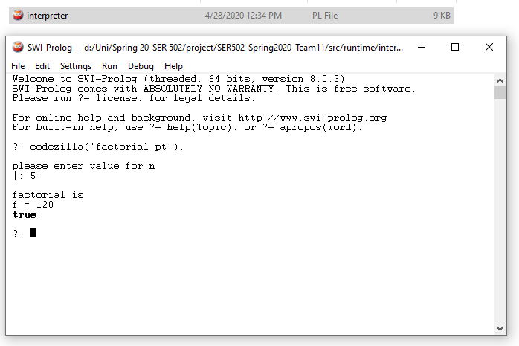
Interpreter

Slide 13
Experience
Hand-construct a lexical analyzer and parser using Definite Clause Grammars (DCG), to recognize and translate a language into an intermediate form.
Understand and design of language runtime environments.
Use regular and context-free language specifiers and recognizers.

Slide 14

Thanks!

